Slide 1


Team 50: Remote Biometric System
Bi-Weekly Update 4 Simon Becker
Andrew-Joseph Nicolas
Lance Pagaduan
Harin Sankar Sponsor: Dr. Steven Wright TA: Hailey Ward
Notes:
Michelle

Slide 2
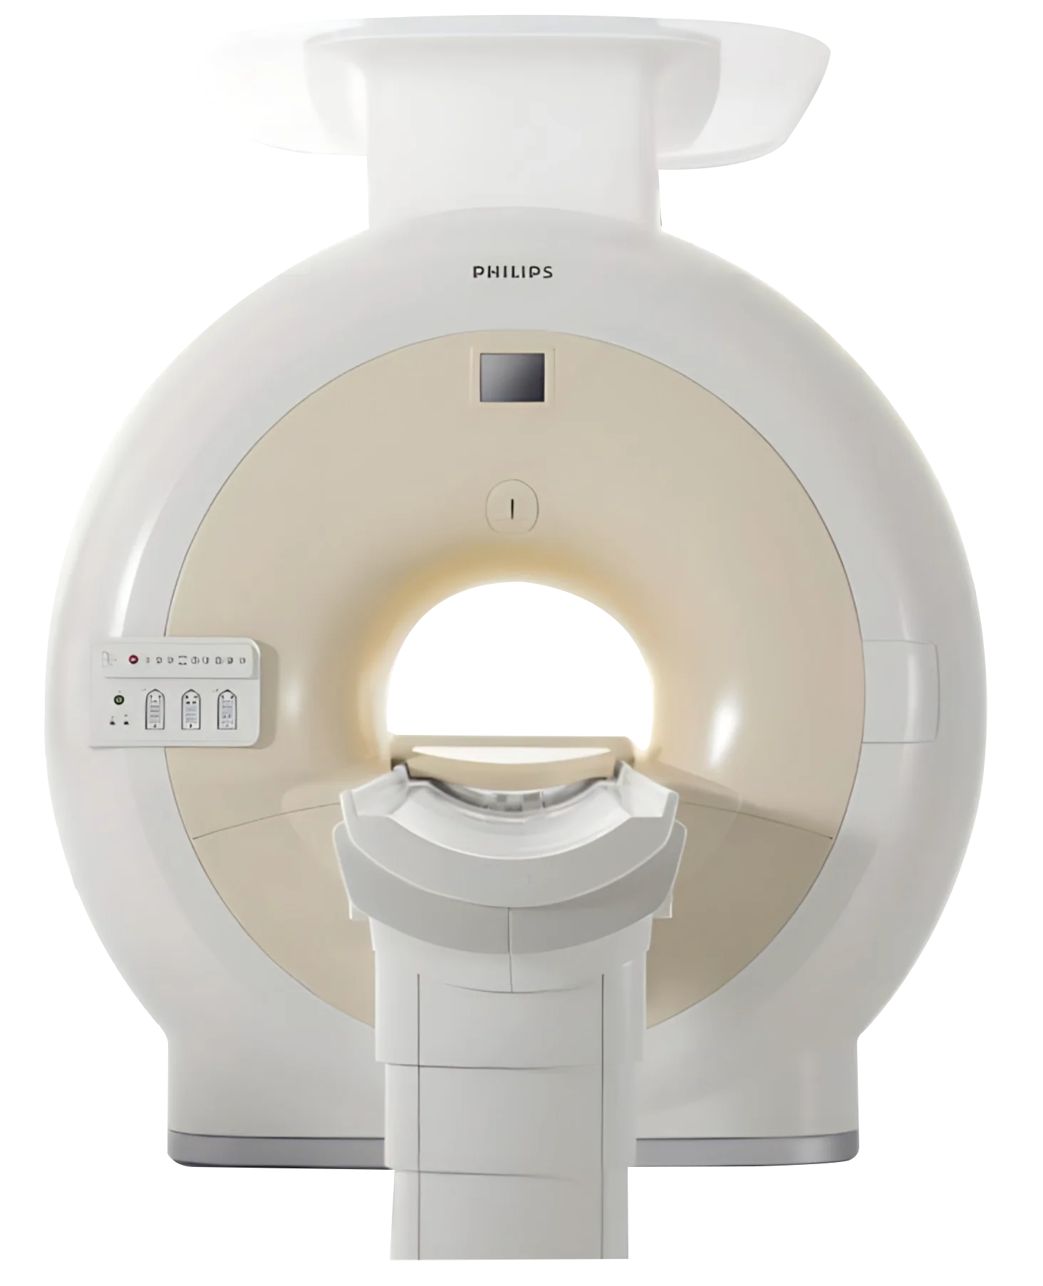

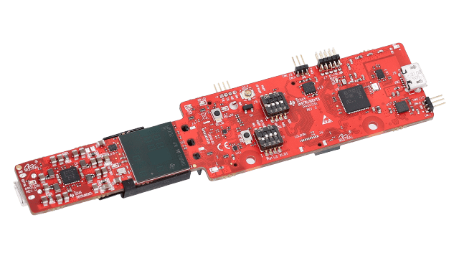
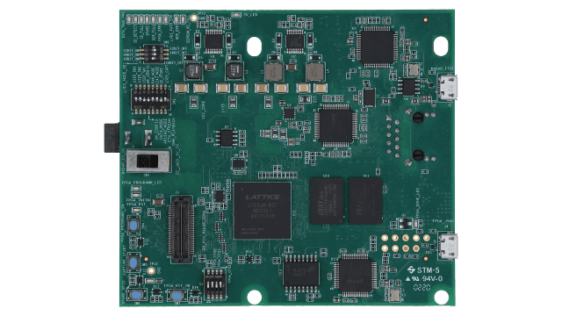
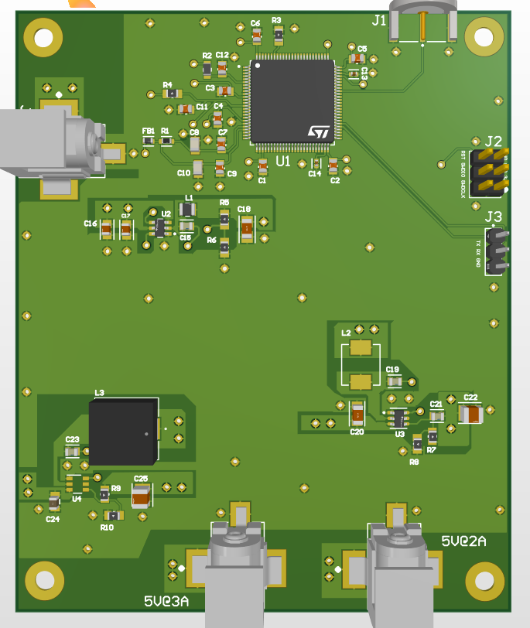
Integrated System Diagram
Hardware
Patient MRI Data
Software
Radar
Cardiac Data
PCB
Data Capture Board

Slide 3
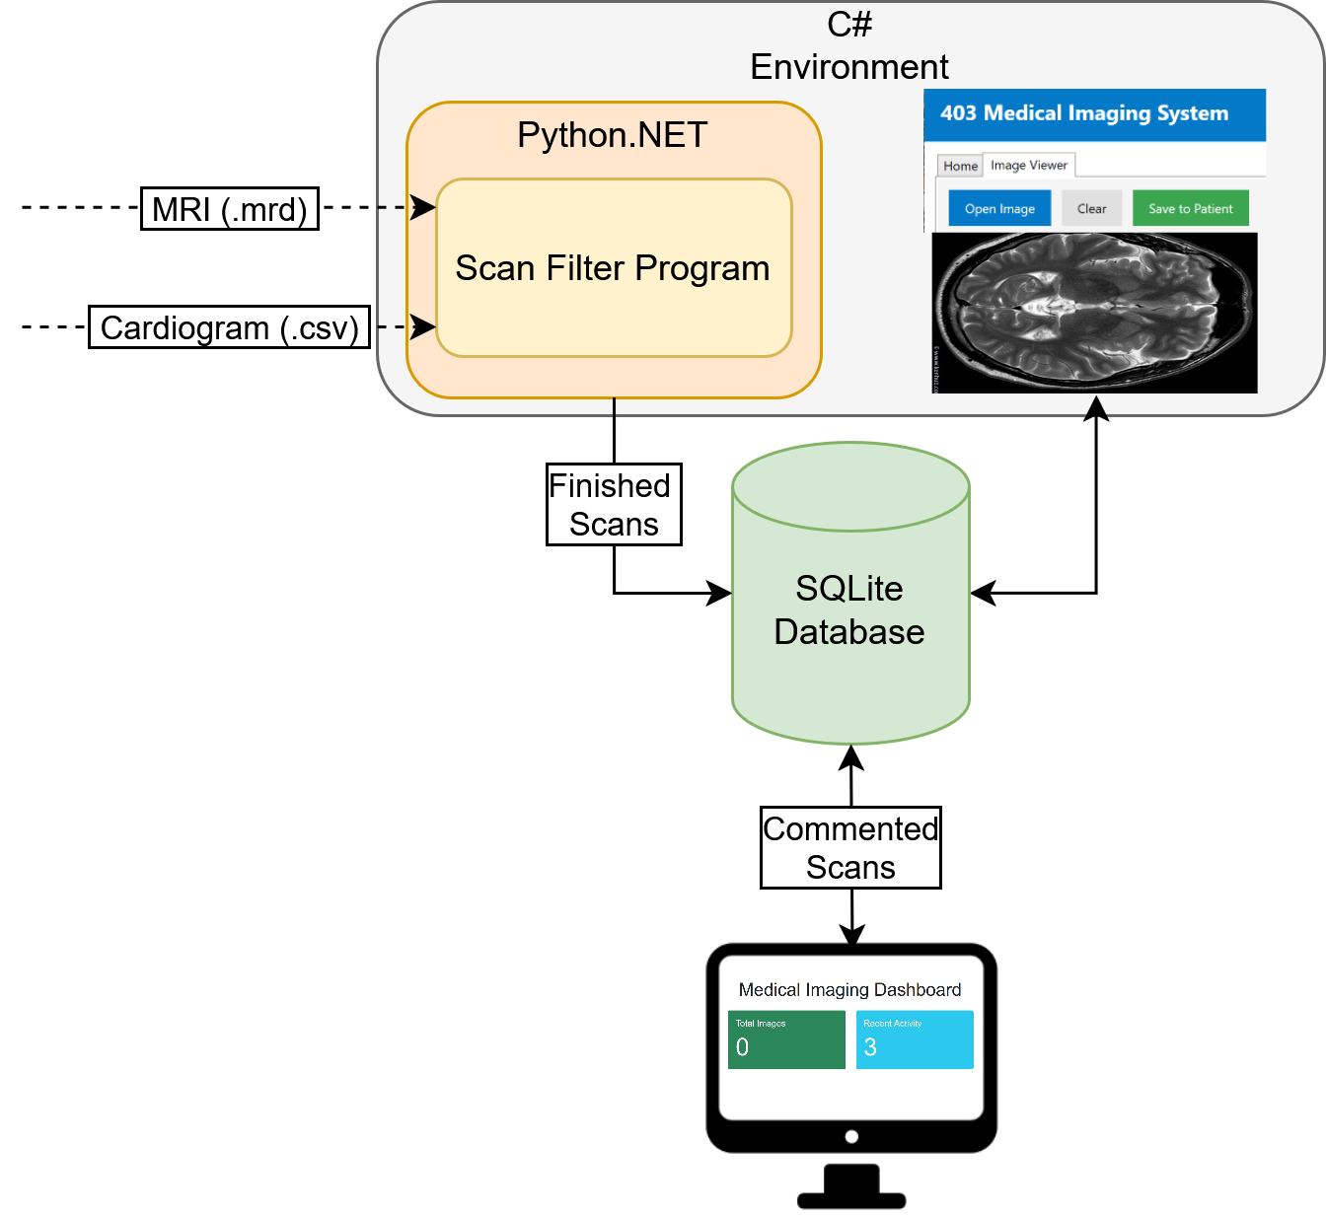
Integrated System Diagram
Software

Slide 4
Project Timeline
Subsystem Designs and Testing (completed 2/2) | PCB Ordered (completed 2/4) | MCU and PCB Functionality Tests (2/26) | Radar & Data Capture Card Integrated (03/04) | MCU and PCB Deployable (to complete by 3/16) | Integration of Scan Filter and MRI (to complete by 3/16) | Integration of Scan Filter and Desktop Application (to complete by 3/16) | System Testing (to complete by 3/23) | Validation (to complete by 4/6) | Demo and Report (to complete by 4/19)
Notes:
Eric

Slide 5
PCB Andrew-Joseph Nicolas
Accomplishments since last update 25 hrs of effort | Ongoing progress/problems and plans until the next presentation
Board fully soldered and tested. All rails work as expected. MCU flashed successfully and passed blink test. | Fully integrate and validate the MCU subsystem on PCB.

Slide 6
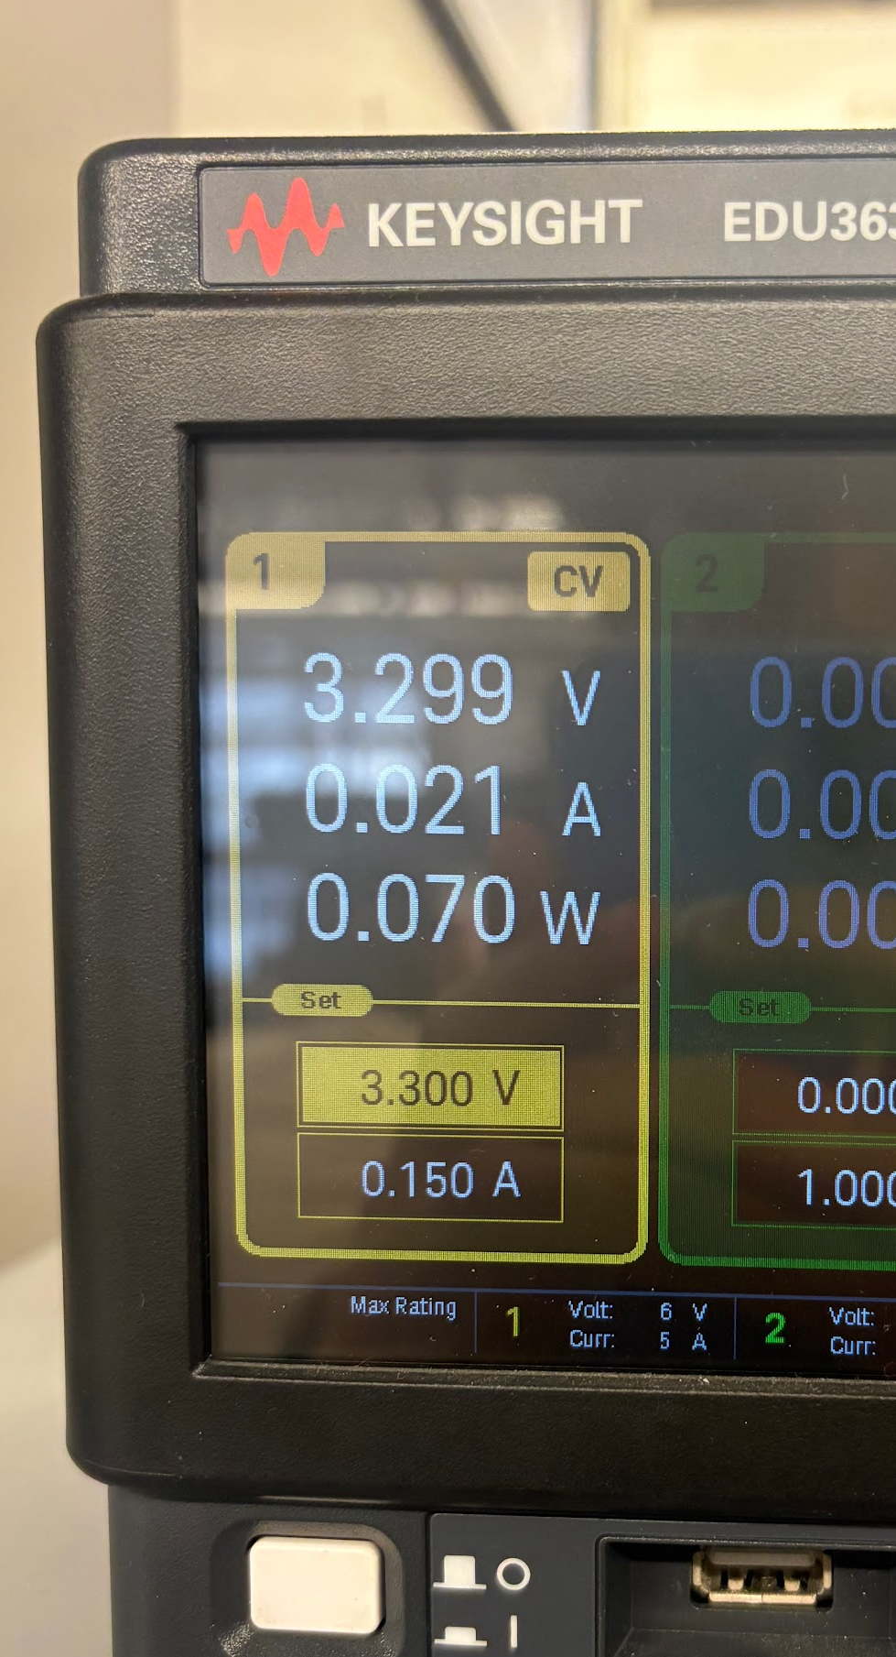
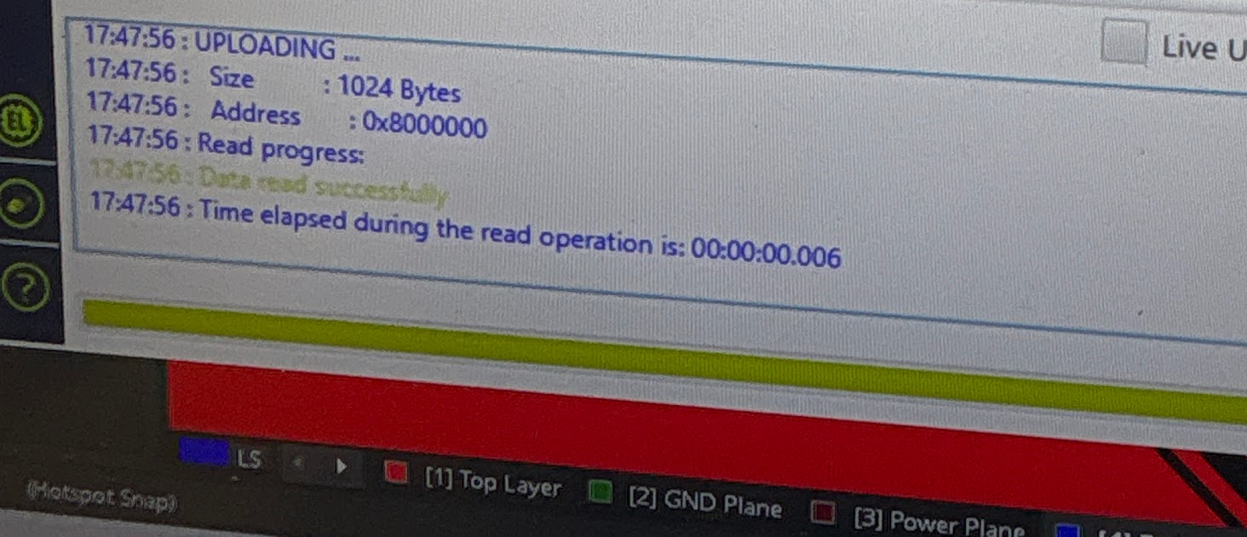
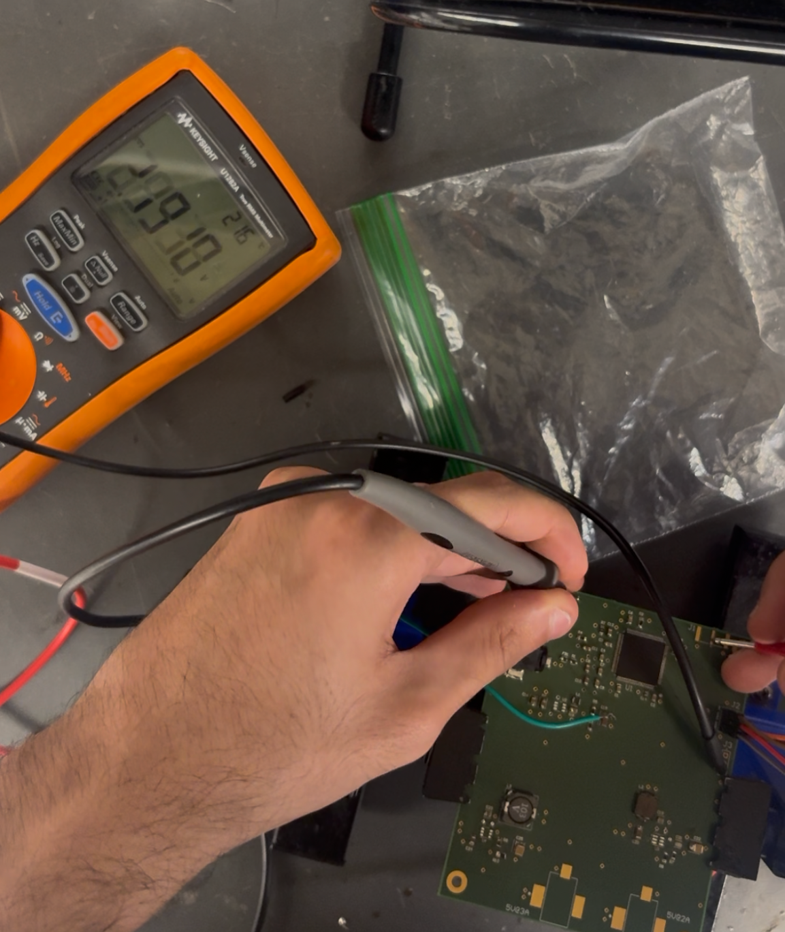
PCB Andrew-Joseph Nicolas
MCU current draw:
Successful communication:
Rail Voltage Measurements:
DC Rail: | Expected Voltage Rating: | Actual Voltage Rating (V)
5V @ 2A | 4.985 | 4.978
5V @ 3A | 4.991 | 4.985
3.3V @ 1A | 3.297 | 3.296
Flash confirmation:

Slide 7
Radar/MCU Lance Pagaduan
Accomplishments since last update 13 hrs of effort | Ongoing progress/problems and plans until the next presentation
Radar outputs accurate and consistent heart rate and respiration rate with adjusted configuration file Radar and data capture card integrated | Begin live testing of raw I/Q data Test MCU code with collected I/Q data to verify correct

Slide 8
Radar/MCU Lance Pagaduan
Radar Testing Changes
Configuration File
Changed the frame period from 90 ms to 70 ms to increase data which updates heart rate more frequently for more accurate readings
Testing Parameters
Patient had no loose clothing
Radar remained in a 1.5m range from the patient while elevated to chest height
Patient remains in an upright position and did not talk during data collection

Slide 9
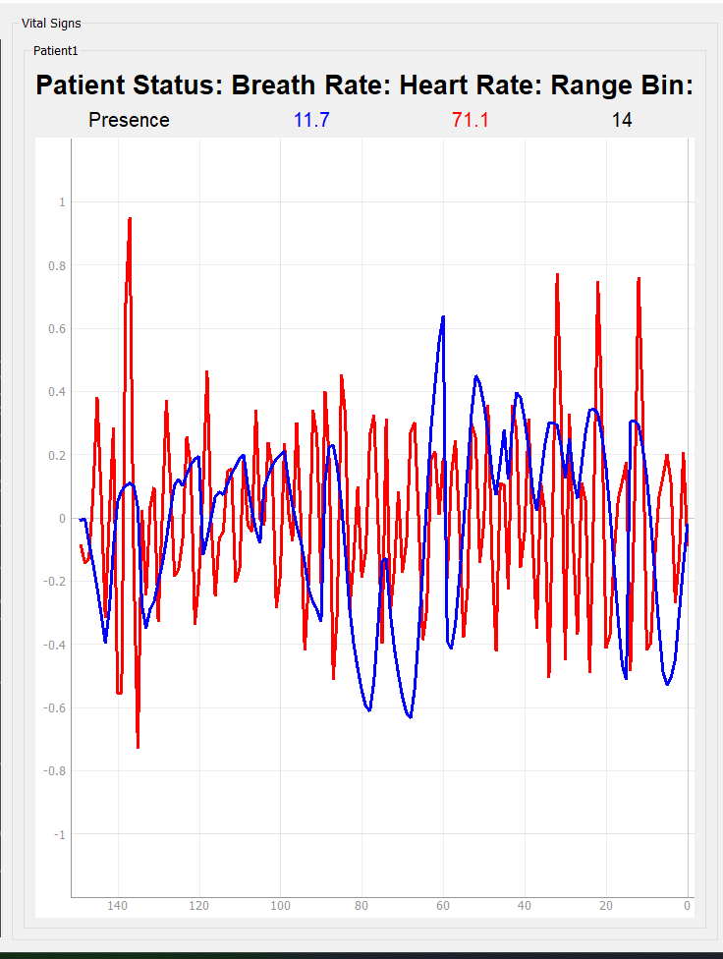
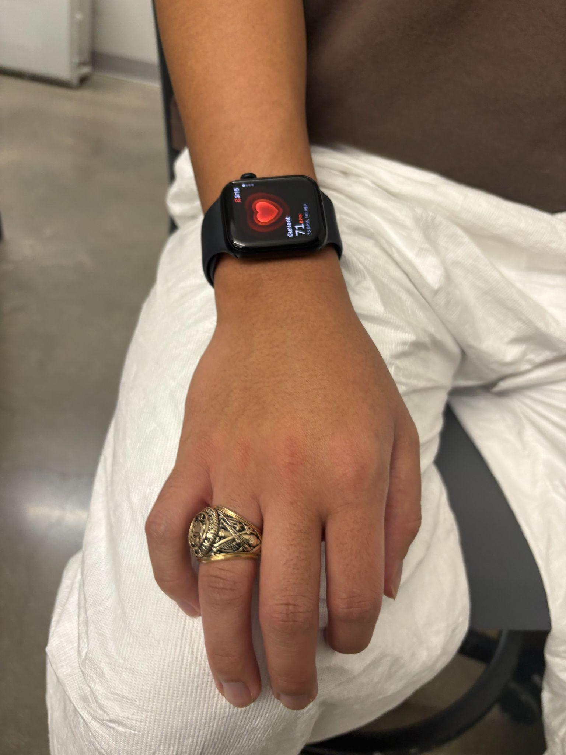
Radar/MCU Lance Pagaduan
Normal Resting Heart Rate Test

Slide 10
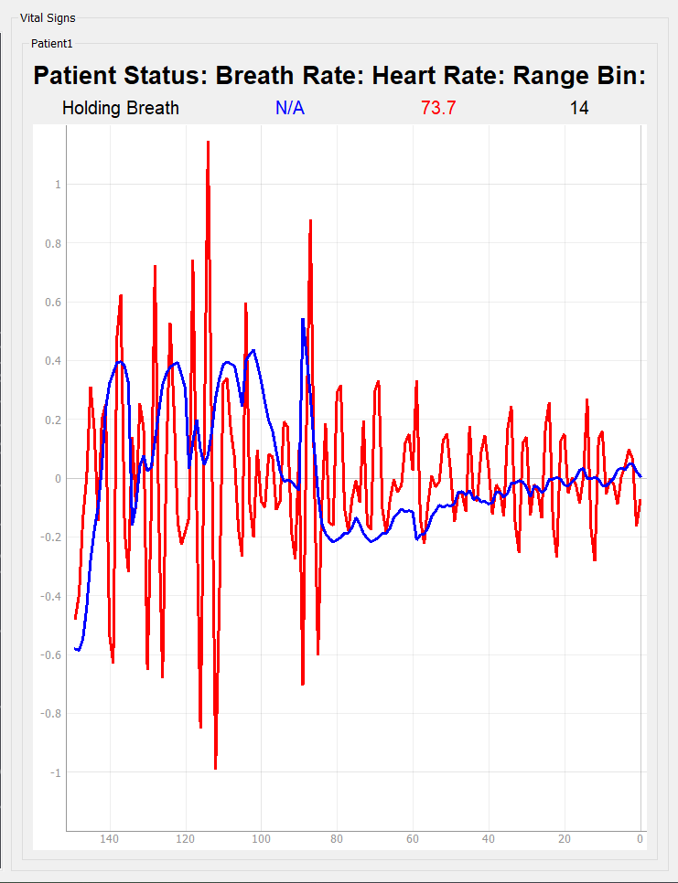
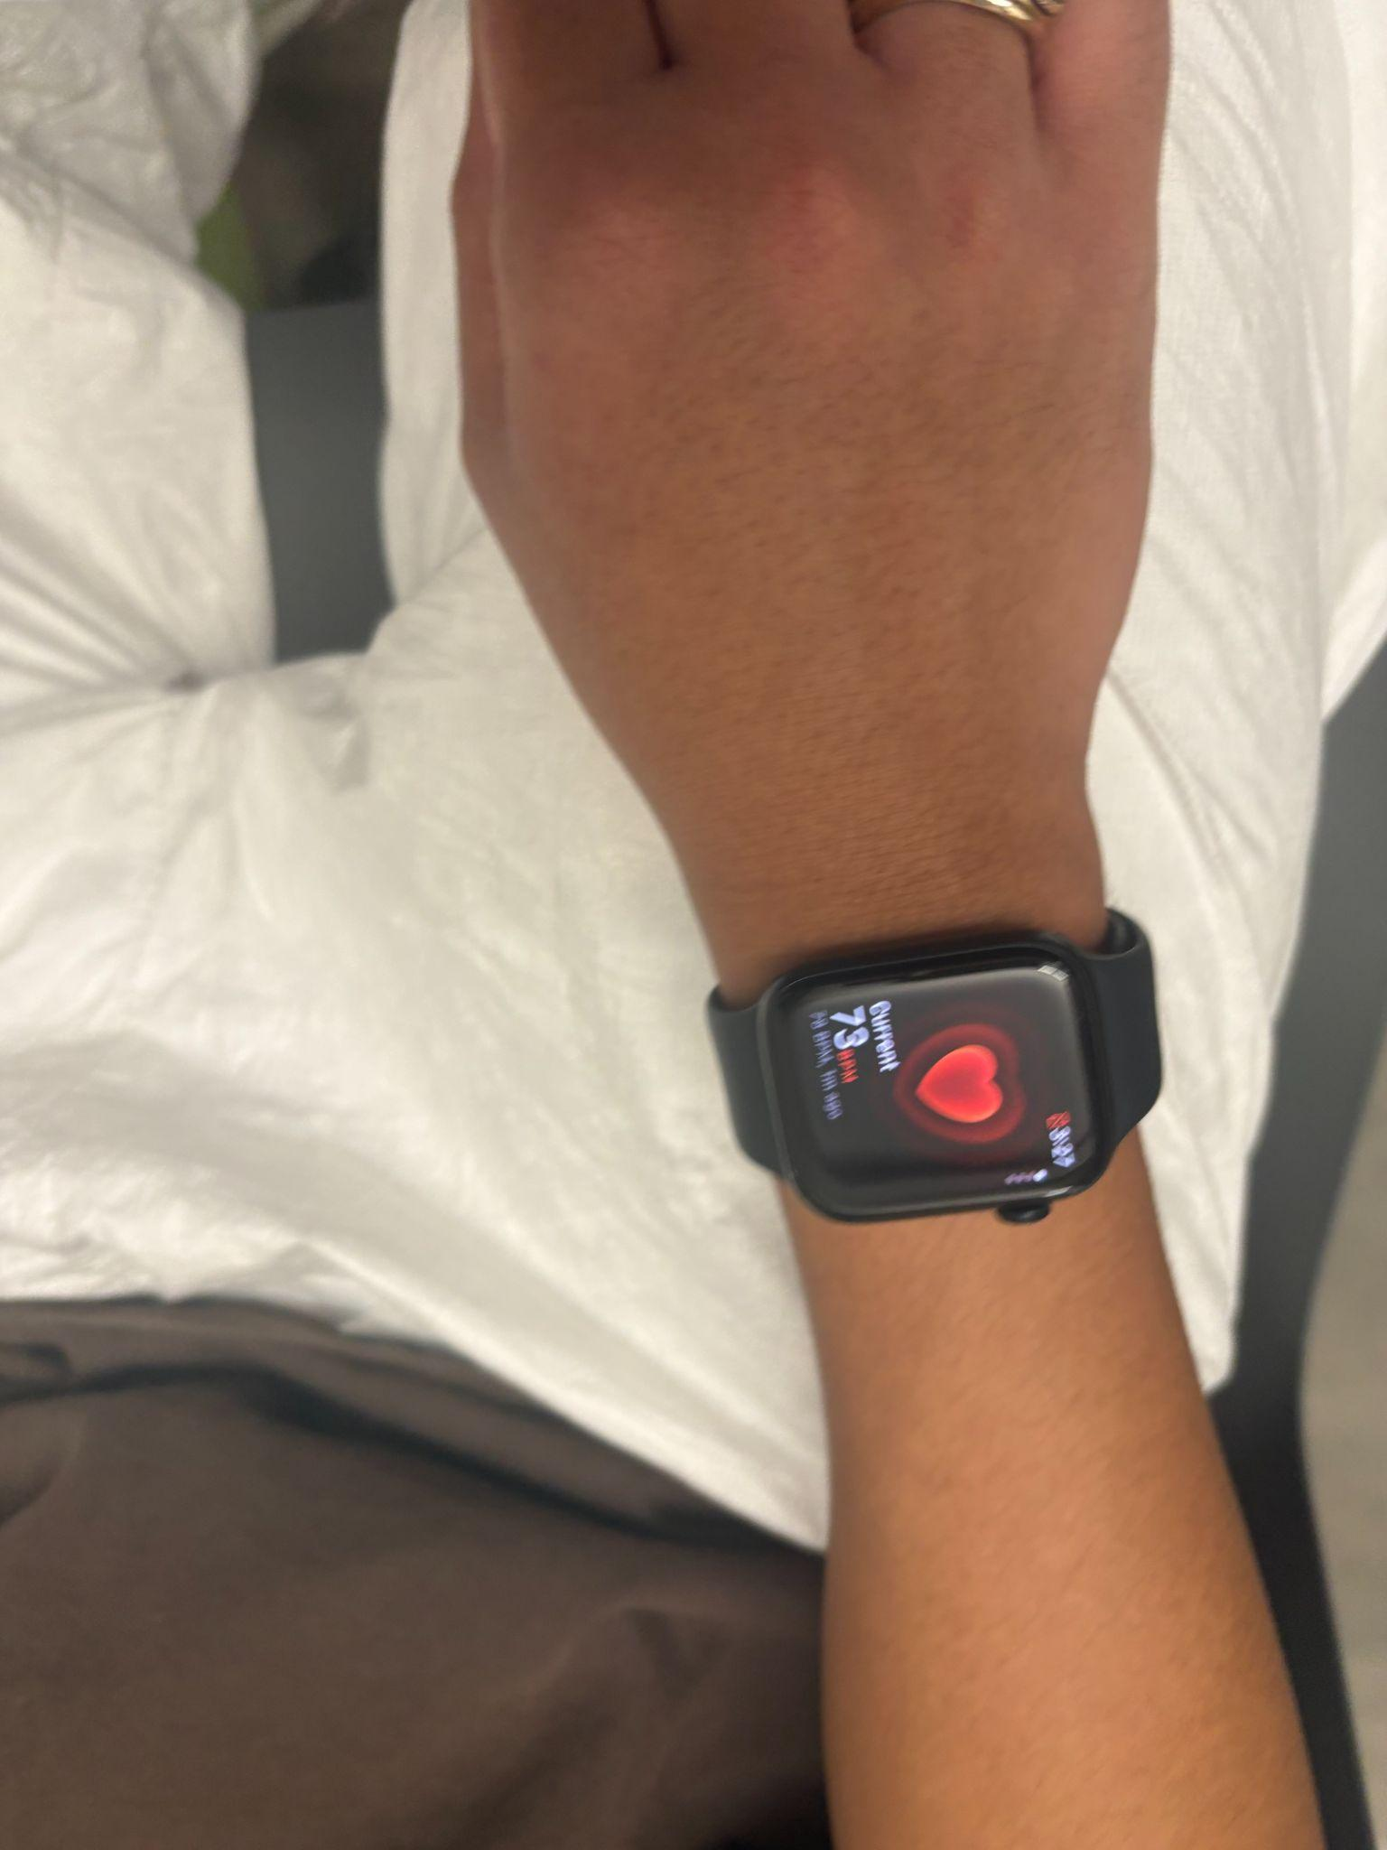
Radar/MCU Lance Pagaduan
Holding Breath Test

Slide 11
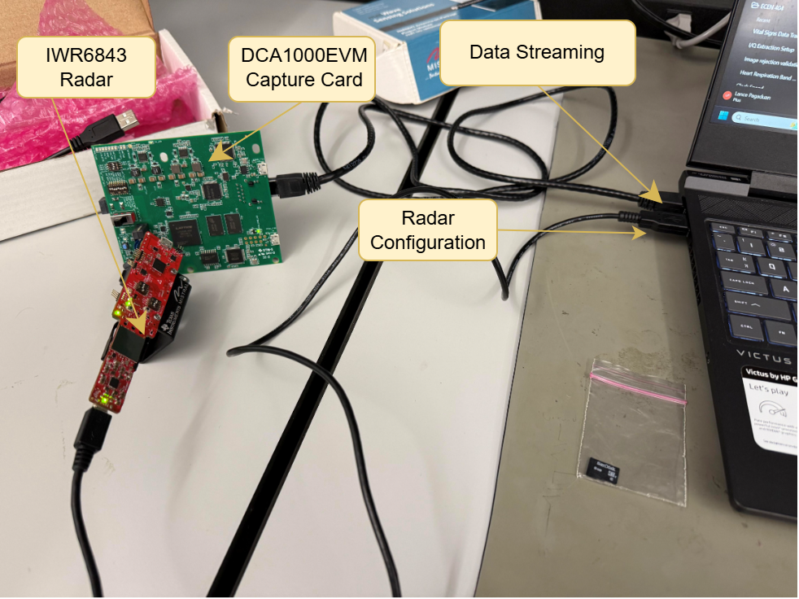
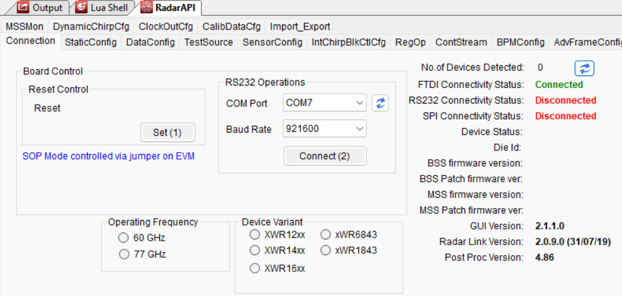
Radar/MCU Lance Pagaduan

Slide 12
Scan Filter Harin Sankar
Accomplishments since last update 15 hrs of effort | Ongoing progress/problems and plans until the next presentation
MCU Integration Simulated whole-file cardiogram transfer and verified ingestion. Simulated live cardiogram streaming and verified ingestion. | MCU Integration Test Python cardiogram ingestion using the actual MCU hardware. MRI Integration Test k-space (.mrd) scans with python reader

Slide 13
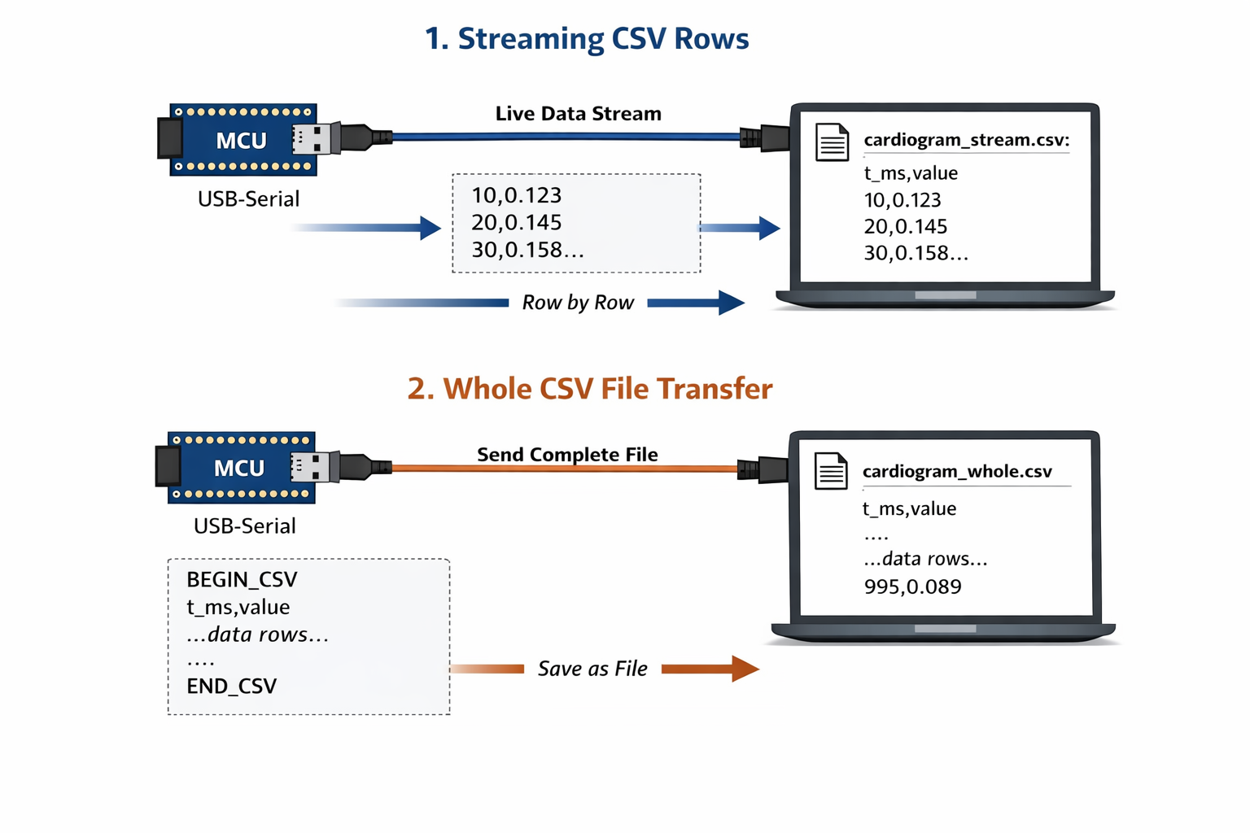
MRI-Scan Filter Integration Harin Sankar

Slide 14
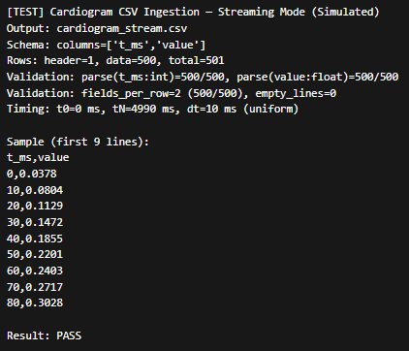
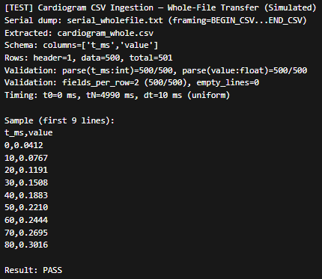
MRI-Scan Filter Integration Harin Sankar
Row Transfer
File Transfer

Slide 15
User Interface Simon Becker
Accomplishments since last update 10 hrs of effort | Ongoing progress/problems and plans until the next presentation
Passed Python.NET testbench | Import Scan Filter code into the Python.NET bridge Testing the output of Scan Filter compatibility with Image Viewer

Slide 16
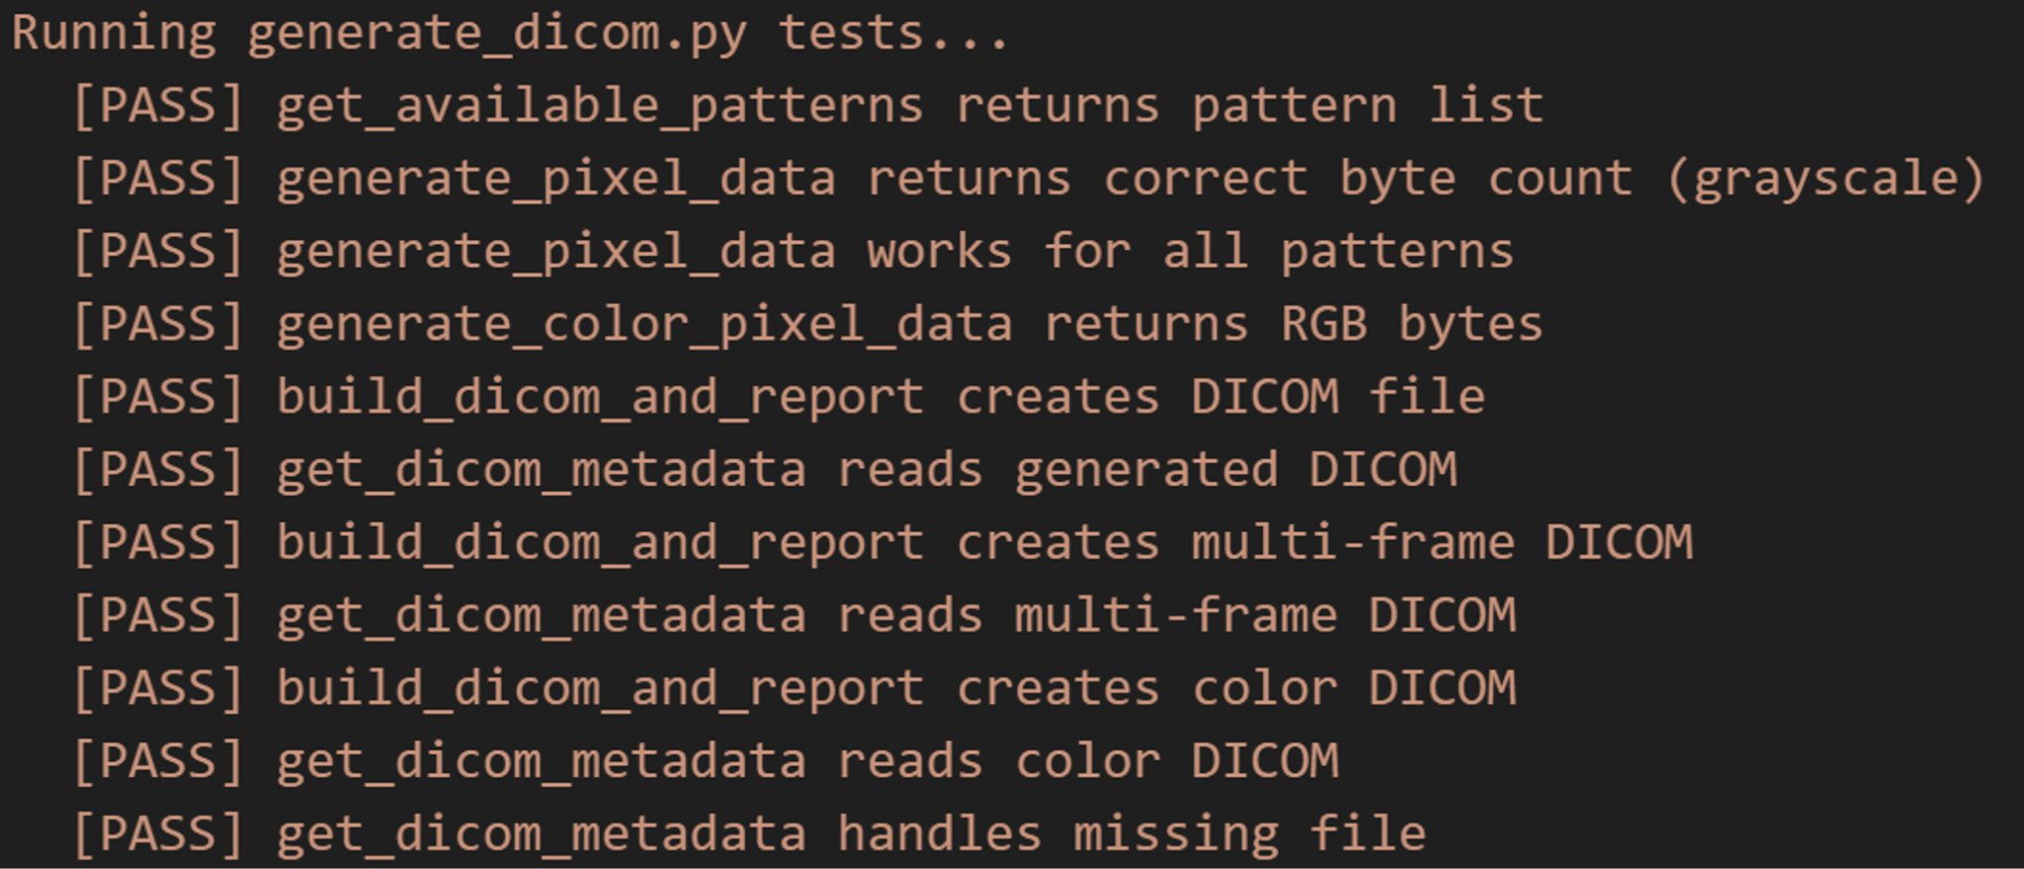
User Interface
Simon Becker
Python.NET Testbench:
Key Functionalities:
Generate DICOM images with metadata
Validate potential MCU inputs (.csv)

Slide 17
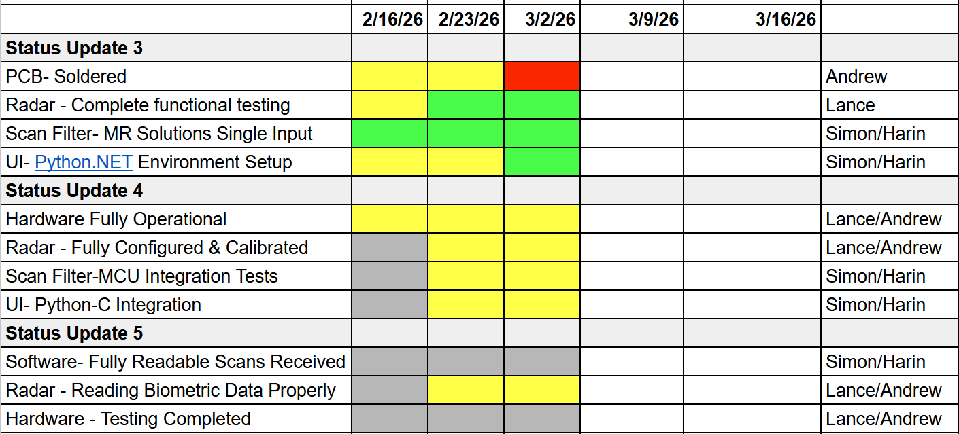
Execution Plan
Notes:
Michelle

Slide 18
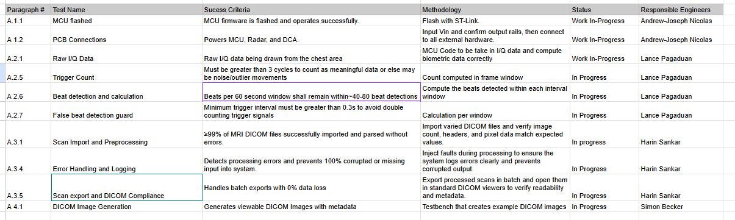
SYSTEM Validation Plan
Notes:
Michelle

Slide 19
Thank You

